Slide 1

Loan data analysis group3

Slide 2

AGENDA
Introduction
Dataset: Loan Data Set
Data Source: Kaggle
Language: Python

Slide 3
INTRODUCTION
When creating a loan prediction model, we usually gather data from financial records and loan applications. These sources give us a deep dive into the financial past of borrowers, helping us assess their creditworthiness accurately. But here's the catch: for our model to be reliable, we need to ensure the data we collect is top-notch in terms of quality and relevance.
This journey isn't without its bumps. Sometimes, we encounter incomplete datasets, which can throw our predictions off course.

Slide 4

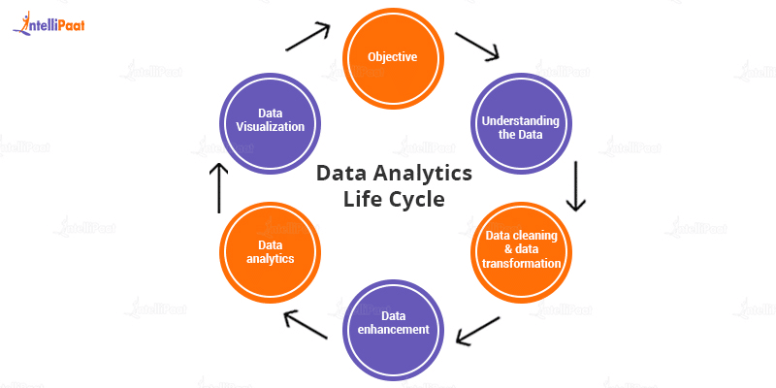
Analysis procedure followed

Slide 5

procedure
Data Collection
Data Cleaning
Exploratory Data Analysis (EDA)
Feature Engineering
Data Preprocessing
Model Selection
Model Training
Model Evaluation
Hyperparameter Tuning
Validation and Testing
Interpretation

Slide 6
Data set summary The dataset has 1 CSV file with 13 columns
Loan_ID
Gender
Married
Dependents
Education
Self_Employed
Applicant Income
Co-applicant Income
LoanAmount
Loan_Amount_Term
Credit_History
Property_Area
Loan_Status

Slide 7
Libraries used
numpy: np
pandas: pd
matplotlib: plt
seaborn: sns
scikit-learn: sklearn
scipy: scipy

Slide 8
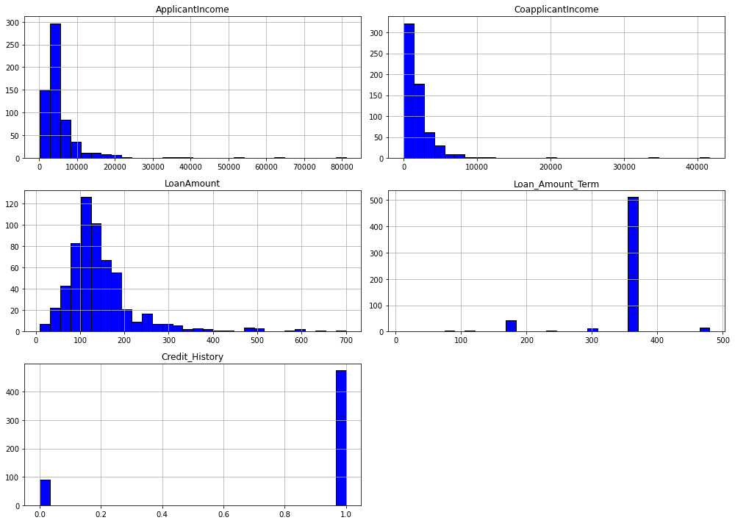
DATA EXPLORATION
Data exploration involves understanding the characteristics and distributions of the variables within a dataset. Histograms provide a visual representation of the frequency distribution of numerical features. By examining the histograms, we can gain insights into the central tendency, spread, and shape of the data distributions.
For instance, the histogram for "Applicant_Income" reveals the distribution of income levels among applicants, showing whether the data is skewed to one side or distributed evenly. Similarly, the histogram for "Co applicant_Income" illustrates the distribution of income levels for co-applicants.
The histogram for "Loan_Amount" displays the distribution of loan amounts requested by applicants, providing insights into the common loan amount ranges. Understanding the distribution of loan amounts is crucial for assessing the risk and feasibility of loan approvals.
Analyzing the histogram for "Loan_Amount_Term" helps understand the distribution of loan term durations, indicating the most prevalent loan term lengths within the dataset.
Moreover, the histogram for "Credit_History" showcases the distribution of credit histories among applicants, which is essential for evaluating creditworthiness and predicting loan approvals.

Slide 9
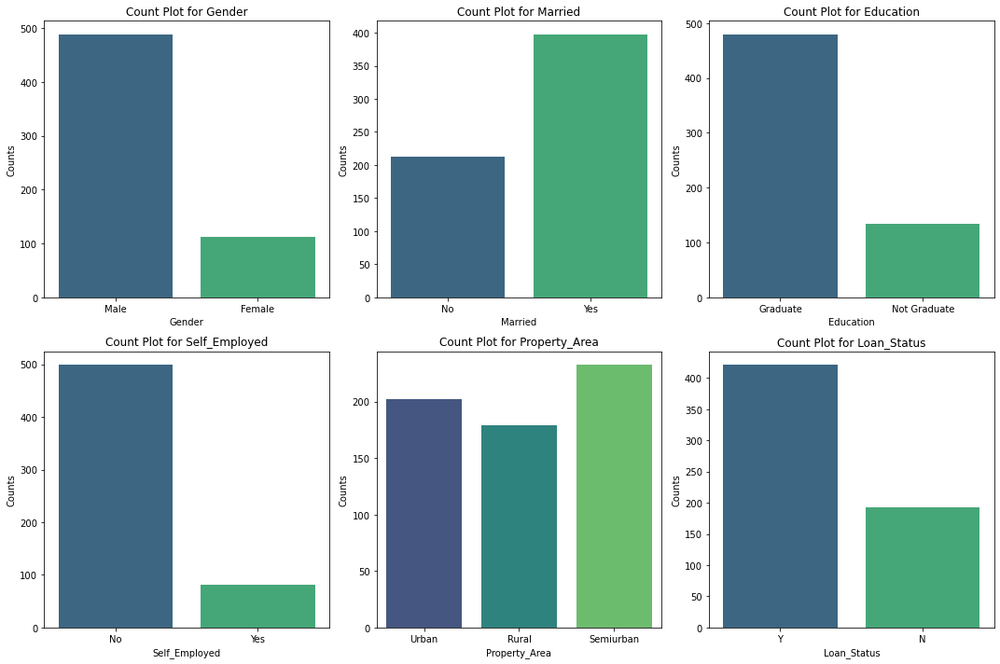
DATA ANALYSIS

Slide 10
Gender Distribution: The count plot for gender shows the distribution of male and female applicants. This information can be crucial for understanding the gender balance within the applicant pool.
Marital Status Distribution: Analyzing the count plot for marital status provides insights into the proportion of married and unmarried applicants. This information is essential for assessing the demographic composition of loan applicants.
Education Level: The count plot for education showcases the distribution of graduate and non-graduate applicants. Understanding the educational background of applicants is vital for evaluating their qualifications and potential financial stability.
Self-Employment Status: Exploring the count plot for self-employment status reveals the proportion of self-employed individuals among loan applicants. This information can influence loan approval decisions and risk assessments.
Property Area Distribution: Analyzing the count plot for property areas provides insights into the distribution of applicants across different regions. This information helps in understanding the geographical spread of loan applicants.
Loan Approval Status: The count plot for loan approval status displays the distribution of approved and rejected loan applications. Understanding the proportion of approved and rejected applications is crucial for evaluating the loan approval process's effectiveness and identifying potential biases.

Slide 11
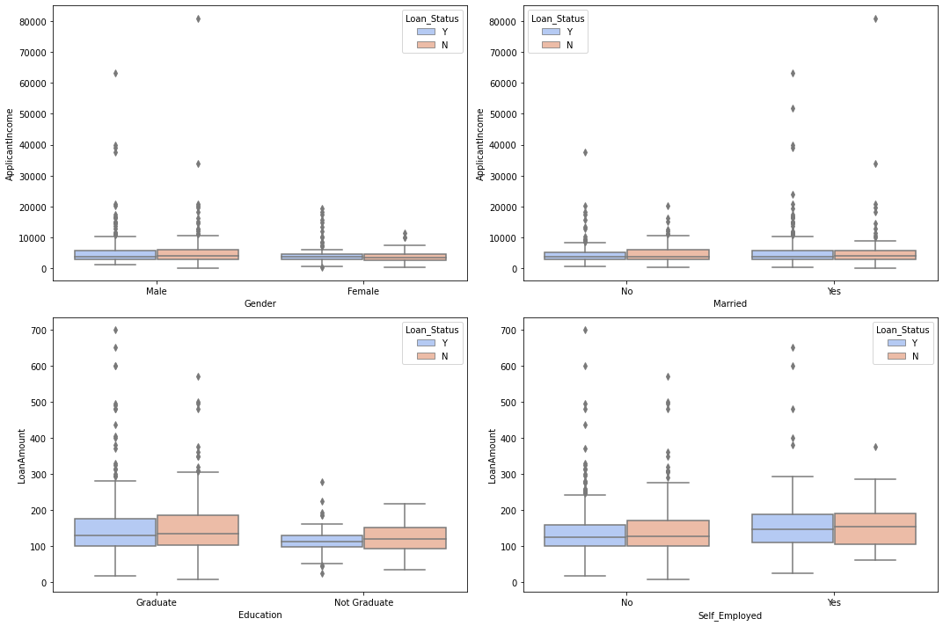
DATA VISUALIZATIO N

Slide 12
Gender vs. Applicant Income and Loan Approval Status: The boxplot illustrates the distribution of applicant income for male and female applicants, differentiated by loan approval status. It provides insights into potential gender-based differences in income levels and loan approval outcomes.
Marital Status vs. Applicant Income and Loan Approval Status: Analyzing the boxplot for marital status versus applicant income and loan approval status helps understand how income levels vary between married and unmarried applicants, considering their loan approval status.
Education Level vs. Loan Amount and Loan Approval Status: The boxplot showcases the distribution of loan amounts for graduate and non-graduate applicants, with a focus on loan approval status. It offers insights into the relationship between education level, loan amounts, and loan approval outcomes.
Self-Employment Status vs. Loan Amount and Loan Approval Status: Exploring the boxplot for self-employment status versus loan amount and loan approval status provides insights into how loan amounts differ between self-employed and non-self-employed applicants, considering their loan approval status.
These visualizations enable a comprehensive exploration of income and loan amount distributions across different categorical features, shedding light on potential patterns, variations, and relationships that may influence loan approval decisions.

Slide 13
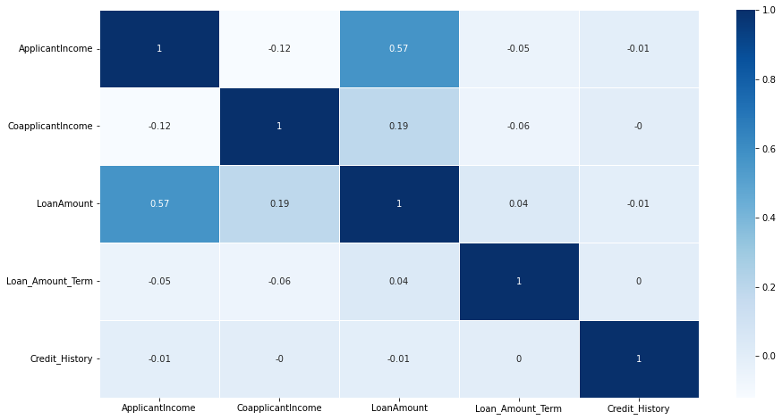
CORRELATIONS
The correlation matrix provides insights into the relationships between variables in the dataset. A correlation coefficient of 1 signifies a perfect positive correlation, indicating that as one variable increases, the other variable also increases. Conversely, a correlation coefficient of -1 signifies a perfect negative correlation, suggesting that as one variable increases, the other variable decreases. A correlation coefficient of 0 indicates no correlation between the two variables.
Correlation matrix:
Applicant income and loan amount exhibit a weak positive correlation, implying that as applicant income increases, loan amount tends to increase slightly.
Co-applicant income and loan amount also demonstrate a weak positive correlation, indicating that as co-applicant income rises, loan amount tends to increase slightly as well.
Loan amount and loan term show a weak positive correlation, suggesting that longer loan terms may be associated with slightly higher loan amounts.
There is no discernible correlation between credit history and any of the other variables, indicating that credit history does not significantly correlate with applicant income, co-applicant income, loan amount, or loan term.

Slide 14
Data Preparation
Data Cleaning: Address missing values and outlier removal as shown in the code where missing values are filled and extreme values are capped.
Data Transformation: Transformation steps include replacing text data with numerical values to facilitate analysis.
Handling Missing Data: Techniques such as imputation with mean or mode.

Slide 15
Feature engineering
Creating new variables that can better represent the underlying patterns in the data to improve model performance.
Selecting relevant features from the dataset that contribute most to the outcome variable.
Transformation techniques such as encoding categorical variables and normalizing incomes.

Slide 16
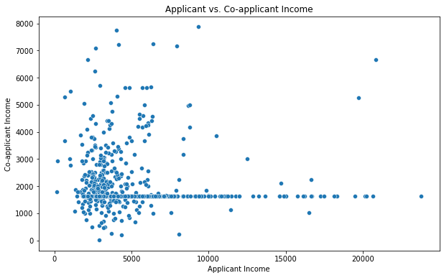
outliers

Slide 17
The scatter plot visualizes the income levels of two individuals, likely a married couple applying for a loan jointly. Each dot on the plot represents a pair of incomes from a single loan application, with the horizontal axis denoting one person's income and the vertical axis representing the other person's income.
The distribution of dots reveals the absence of a clear relationship between the incomes of the two applicants. While some couples exhibit similar income levels, indicating relatively equitable financial contributions, others display significant disparities, with one partner earning notably more than the other. This variance underscores the diversity in financial situations among loan applicants and highlights the complexity of household income dynamics.
The scatter plot provides insights into the diversity of financial partnerships, reflecting the varying arrangements and contributions within couples or cohabitating individuals. Some pairs may have similar income levels due to shared financial resources or similar career trajectories, while others may have divergent incomes resulting from disparities in employment status, education level, or other factors.
The scatter plot solely depicts income distribution and does not provide insights into the loan approval process. While income is a critical factor in loan eligibility assessments, other variables such as credit history, debt-to-income ratio, and property value also influence loan approval decisions. Therefore, while income levels are an important consideration, they represent just one aspect of the broader loan application evaluation process.

Slide 18
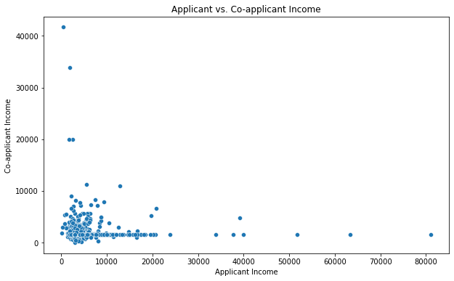
DISCREPANCIES
The scatter plot highlights potential outliers, indicating discrepancies in applicant and co-applicant incomes.
Outliers may stem from data entry errors, reporting inconsistencies, or genuine variations in financial circumstances.
Validating outlier data points through cross-referencing with external sources is crucial to ascertain their accuracy.
Resolving discrepancies involves employing data cleaning techniques such as outlier removal, data transformation, or imputation methods.
Assessing the impact of discrepancies on data analysis outcomes is essential to ensure the reliability of insights derived from the data.
Documentation of the discrepancy identification process enhances transparency and reproducibility in data analysis.

Slide 19
MODELS USED
We have used Random forest, Logistic regression, SVM as our models.
Random Forest:
Random Forest is an ensemble learning method based on decision trees. It builds multiple decision trees during training and outputs the mode of the classes (classification) or average prediction (regression) of individual trees.
Random Forest is effective for analyzing loan data due to its ability to handle complex relationships between features and predict loan outcomes accurately. It can identify important features such as credit score, income, loan amount, and employment status, which influence the likelihood of loan default or approval. Additionally, Random Forest can handle missing values and outliers in the data effectively, making it robust for real-world loan datasets.

Slide 20
Models used
Logistic Regression:
Logistic Regression is a statistical method used for binary classification tasks. It models the probability of a binary outcome (e.g., default or non-default) based on one or more predictor variables.
Logistic Regression is commonly used in loan data analysis to predict the likelihood of loan default based on borrower characteristics and loan attributes. By estimating the probability of default, lenders can assess credit risk and make informed decisions on loan approvals and interest rates. Logistic Regression also provides interpretable coefficients, allowing lenders to understand the impact of each predictor variable on the probability of default.
Support Vector Machines (SVM):
Support Vector Machines is a supervised learning algorithm used for classification and regression tasks. It finds the hyperplane that best separates the classes in the feature space by maximizing the margin between the classes.
SVM is applicable in loan data analysis for binary classification tasks, such as predicting loan default or non-default. By mapping loan data into a high-dimensional space, SVM can effectively classify borrowers into different risk categories based on features like credit score, income, and loan history. SVM can handle non-linear decision boundaries through kernel functions, making it suitable for complex loan datasets with non-linear relationships between features.

Slide 21
Model evaluation
Accuracy, F1 Score, Recall, and Precision metrics are used to evaluate model performance. All these metrics for the 3 classifiers used in our project are as follows:
Random Forest - Accuracy: 0.825, F1 Score: 0.8877005347593583, Recall: 0.7980769230769231, Precision: 1.0
Logistic Regression - Accuracy: 0.825, F1 Score: 0.8877005347593583, Recall: 0.7980769230769231, Precision: 1.0
SVM - Accuracy: 0.7916666666666666, F1 Score: 0.8677248677248677, Recall: 0.7735849056603774, Precision: 0.9879518072289156

Slide 22
Model comparison & results
Based on the performance metrics provided:
Random Forest and Logistic Regression both achieved the highest scores in terms of accuracy (82.5%) and F1 Score (88.77%), with both also showing a perfect precision of 100% and a recall of approximately 79.81%. This suggests that when these models predict a loan approval, they are extremely reliable, with no false positives recorded.
Support Vector Machine (SVM), while slightly behind in accuracy (79.17%) and recall (77.36%), still performed very well in terms of precision (98.80%) and had a reasonably high F1 Score (86.77%).

Slide 23

Deployment Strategies
Deploying a model for real-time predictions in a loan data analysis project involves careful planning and implementation to ensure accuracy, reliability, and scalability. Here's a deployment strategy tailored to such a scenario:
Infrastructure Setup: Choose a robust and scalable infrastructure for deploying the model. Cloud platforms like AWS, Azure, or Google Cloud provide services such as AWS Lambda, Azure Functions, or Google Cloud Functions, which can be used to deploy models as serverless functions, enabling automatic scaling and reducing operational overhead.
API Development: Develop a RESTful API using frameworks like Flask or Fast API to expose the model for real-time predictions. Design the API endpoints to accept loan application data (e.g., applicant income, co-applicant income, loan term, credit history) and return the predicted loan amount.
Input Data Validation: Implement input data validation in the API to ensure that incoming requests contain valid and consistent data. Validate the format, range, and type of input parameters to prevent errors and maintain data integrity.
Model Deployment: Deploy the packaged model and API on the chosen infrastructure, whether it's a serverless platform or a containerized environment. Configure auto-scaling policies to handle varying prediction loads efficiently and ensure high availability.

Slide 24
Conclusion
Effectiveness of Machine Learning Models
The application of Random Forest, Logistic Regression, and SVM demonstrated significant predictive capabilities in determining loan approval outcomes. Each model brought its strengths in terms of accuracy, precision, and recall, illustrating the potential of machine learning in financial decision-making.
Importance of Precision in Financial Decisions
Precision was a critical metric in this analysis, especially for financial institutions aiming to minimize false positives in loan approvals. Both the Random Forest and Logistic Regression models achieved a precision of 100%, highlighting their reliability in predicting valid loan approvals and ensuring financial security.
Future Steps for Model Improvement and Deployment
While the current models performed well, continuous improvement through further parameter tuning, feature engineering, and the incorporation of additional data could enhance their accuracy and applicability. Deploying these models in a real-world environment would also involve regular performance evaluations and updates to adapt to changing financial landscapes and borrower profiles.

Slide 25
References
https://www.kaggle.com/datasets/burak3ergun/loan-data-set
0_Daniel T. Larose-Discovering Knowledge in Data_ An Introduction to Data Mining-Wiley-Interscience (2004)-3.pdf
https://www.datacamp.com/blog/machine-learning-lifecycle-explained
https://www.w3schools.com/python/python_ml_getting_started.asp

Slide 26

ANY QUERIES

Slide 27

THANK YOU

